Slide 1
Multiple Linear Regression
Team Members:
Amey Mahendra Thakur,
Jithin Gijo Varghese,
Ritika Agarwal
Instructor: Dr. Yasser Alginahi
Date: 29th September 2023
University of Windsor

Slide 2
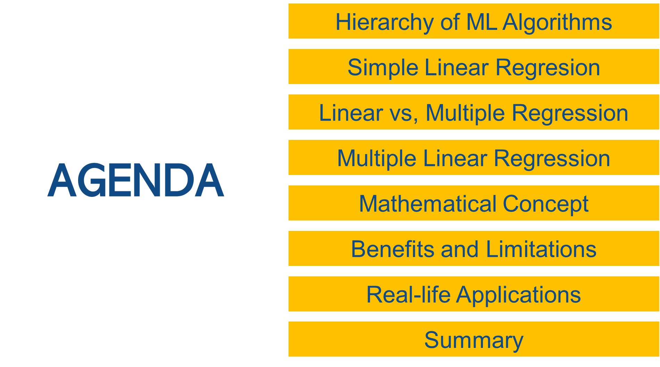

Slide 3
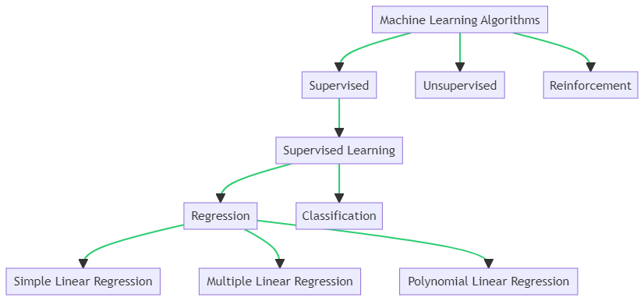
Hierarchy of Machine Learning Algorithms

Slide 4
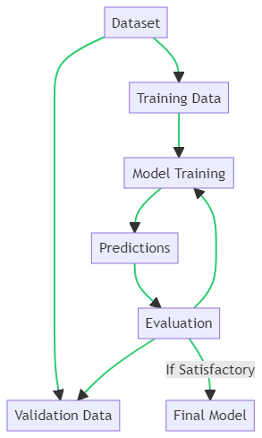
Supervised Learning Workflow
Dataset is split into Training Data and Validation Data.
Training Data is used for Model Training.
The trained model makes Predictions.
Predictions are Evaluated using the Validation Data.
If the evaluation is satisfactory, we get the Final Model, else the model is retrained.

Slide 5
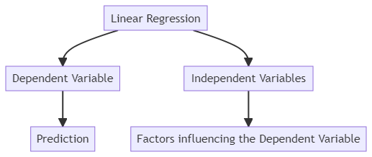
Simple Linear Regression
Linear regression is a statistical technique that finds the best-fitting straight line to show how a dependent variable (the one we want to predict, often denoted as "Y") is related to one independent variables (the factor or input we use to make predictions, often denoted as "X").

Slide 6
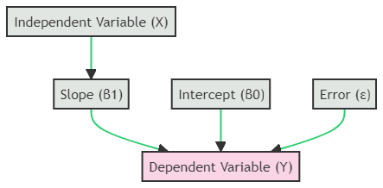
Linear Regression Equation
Linear regression is a statistical technique that finds the best-fitting straight line to show how a dependent variable (Y) is related to one independent variable (X). The equation is given by Y=β0+β1X+ϵ, where β0 is the y-intercept, β1is the slope, and ϵ is the error term.
Y=β0+β1X+ϵ

Slide 7
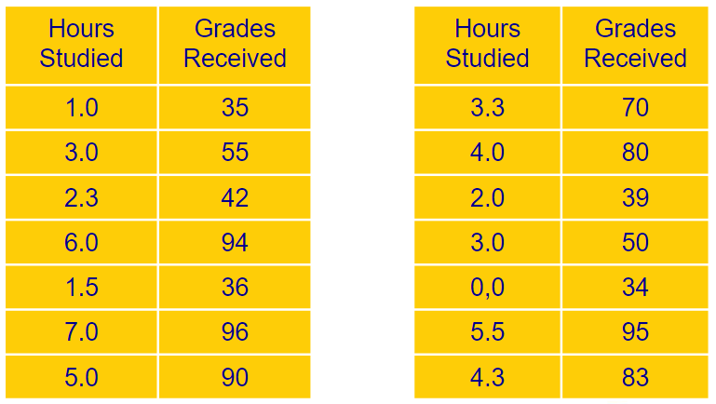
Example - Correlation Between Study Hours and Grades
The dataset shows a potential positive correlation between study hours and grades. More study hours might lead to higher grades. This data is pivotal for further analyses like linear regression.

Slide 8
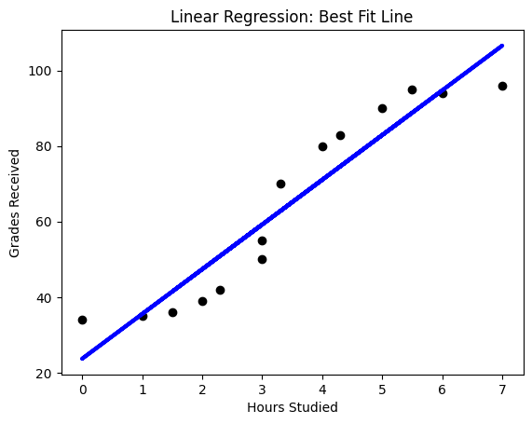
Relationship between Hours Studied and Grades Received
Grade=β0+β1×Study Time
Where:
β0 is the y-intercept (grade when study time is zero).
β1 is the slope, indicating the change in grade for each additional hour of study.

Slide 9
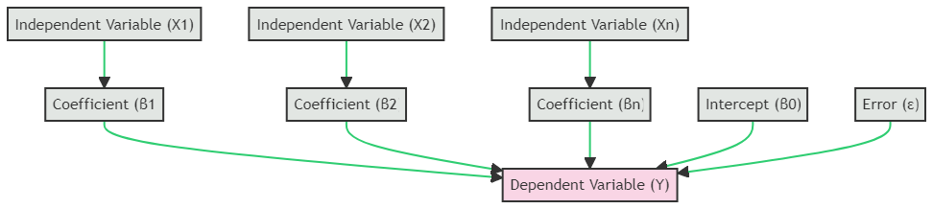
Multiple Linear Regression
Multiple Linear Regression is an extension of simple linear regression. It is used to predict the value of a dependent variable based on the values of multiple independent variables. The relationship is represented by the equation:
Y=β0​+β1​x1+β2​x2+…+βn​xn​+ϵ

Slide 10
Multiple Linear Regression
In multiple linear regression, we model the relationship between multiple independent variables (features) and a dependent variable.
The equation for multiple linear regression is:
y=β0​+β1​x1+β2​x2+…+βn​xn​+ϵ
y is the dependent variable (what we are trying to predict).
β0 is the y-intercept.
β1,β2,…,βn are the coefficients of the independent variables.
x1,x2​,…,xn​ are the independent variables (features).
ϵ is the error term.

Slide 11
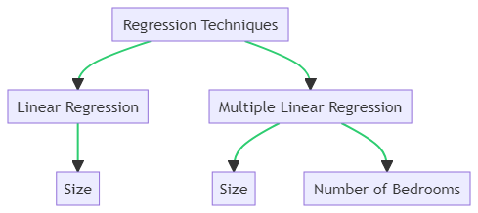
Linear vs. Multiple Linear Regression
Linear Regression and Multiple Linear Regression are both statistical techniques used to predict the value of a dependent variable based on the values of independent variable(s), but they differ in the number of independent variables used.

Slide 12
Linear vs. Multiple Linear Regression
Regression techniques are statistical methods used to predict the value of a dependent variable based on one or more independent variables. In the context of house price prediction:
Linear Regression: A method that predicts house prices based solely on the "Size" of the house. It establishes a relationship between the house price and its size.
Multiple Linear Regression: An advanced technique that considers multiple factors, such as the "Size" and the "Number of Bedrooms", to predict house prices. It provides a more comprehensive model by incorporating multiple features of the house.
Both techniques aim to offer accurate predictions, but the choice between them depends on the available data and the complexity of the relationship being studied.

Slide 13
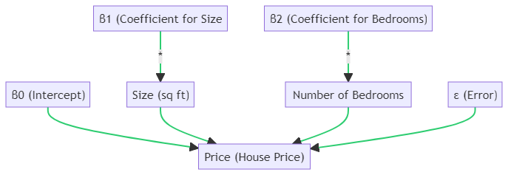
Example - House Price Prediction with Multiple Regression
Price=β0+β1​(Size)+β2​(Bedrooms)+ϵ

Slide 14
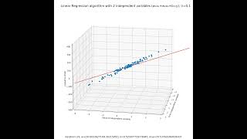
Source: “3D Visualization of Linear Regression with multiple independent variables,” www.youtube.com. https://youtu.be/6xnn5Mm4-tE

Slide 15
How well Regression Model Fits Data?
R-squared measures overall model goodness of fit.
Evaluates how well the model explains dependent variable variation.
Higher R² indicates better overall fit (0 to 1).
p-values assess individual variable significance.
Determines if each variable contributes significantly to the model.
Low p-values (<0.05) imply significance.

Slide 16
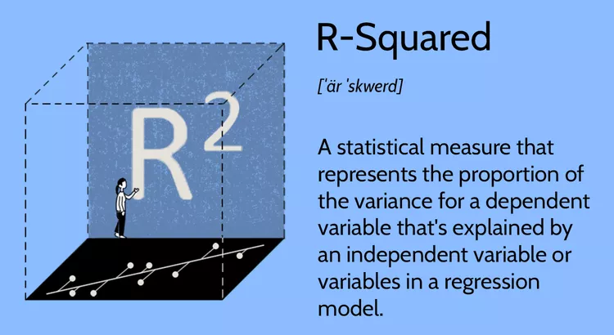
R-squared (R²)
R-squared (R²) measures how well a regression model fits data.
It ranges from 0 to 1, with 1 meaning a perfect fit.
Higher R² values indicate better model fit.
R² doesn't explain variable significance.
Source: J. Fernando, “R-Squared Definition,” Investopedia, Apr. 08, 2023. https://www.investopedia.com/terms/r/r-squared.asp
Note:
A high R² does not necessarily mean a good model; it could be overfitting. Always consider other model evaluation metrics.

Slide 17
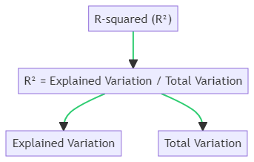
Understanding R-squared (R²)
Equation:
Where,
Explained Variation: The variation in the dependent variable explained by the regression model.
Total Variation: The overall variability present in the dependent variable.

Slide 18
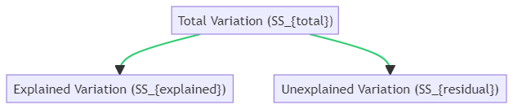
Understanding R-squared (R²)
Explained Variation: (SSexplained): Represents the portion of the total variation in the dependent variable that is captured by the regression model. It quantifies the variability attributed to the relationship with the independent variable(s).
Unexplained Variation (SSresidual): The portion of the total variation that the model fails to explain. It's the difference between the observed values and the predicted values from the model.
Total Variation (SStotal): The overall variability in the dependent variable without considering the effect of the independent variable(s). It's the sum of the Explained and Unexplained Variations.

Slide 19
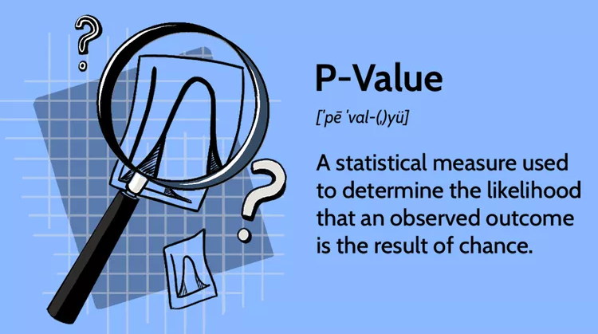
Understanding p-values
P-values test variable significance in a regression model.
Low p-values (<0.05) mean significance.
High p-values suggest insignificance.
Use p-values to decide variable inclusion.
Source: B. Beers, “What P-Value Tells Us,” Investopedia, May 18, 2022. https://www.investopedia.com/terms/p/p-value.asp‌

Slide 20
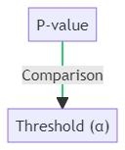
Understanding p-values
The P-value is a measure used in hypothesis testing to determine the significance of results. It's compared against a predetermined threshold, often denoted as α (commonly set at 0.05).
If the P-value is less than α, the result is considered statistically significant, and the null hypothesis is rejected.
If the P-value is greater than or equal to α, there's insufficient evidence to reject the null hypothesis.
The P-value tells us if the observed data is consistent with the null hypothesis or if it's rare under the assumption that the null hypothesis is true.

Slide 21
Assumptions of Multiple Linear Regression
A linear relationship between the dependent and independent variables.
The independent variables are not highly correlated with each other.
The variance of the residuals is constant (i.e., differences between predicted and actual values).
Each data point shouldn't depend on others; they should be separate.
All variables should be normally distributed.

Slide 22
Benefits of Multiple Linear Regression
Predictive Power
Predict dependent variable based on multiple independent variables.
Quantifying Relationships
Measures strength and direction of relationships.
Control for Confounding Factors
Accounts for other influencing variables.
Model Interpretability
Coefficients offer insights into variable impact.
Assumption Testing
Provides diagnostic tools for model quality.

Slide 23
Limitations of Multiple Linear Regression
Linearity Assumption
Assumes linear relationships.
Multicollinearity
High correlations among variables can lead to instability.
Overfitting
Too many variables can cause poor generalization.
Assumption Violations
Relies on normality, homoscedasticity, and independence.
Handling Categorical Variables
Requires encoding, adding complexity.
Data Requirements
Needs a large dataset for reliable results.

Slide 24


Real-Life Applications of Multiple Regression
Economics and Finance:
Stock Price Prediction
Economic Forecasting

Slide 25


Real-Life Applications of Multiple Regression
Healthcare:
Medical Research
Hospital Readmission Prediction

Slide 26


Real-Life Applications of Multiple Regression
Marketing:
Sales Forecasting
Market Research

Slide 27
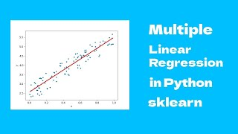
Source:“Multiple Linear Regression in Python - sklearn,” www.youtube.com, https://youtu.be/wH_ezgftiy0

Slide 28
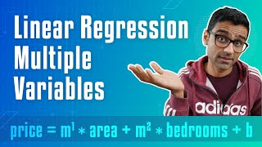
Source: “Machine Learning Tutorial Python - 3: Linear Regression Multiple Variables,” www.youtube.com. https://youtu.be/J_LnPL3Qg70

Slide 29
Summary
Hierarchy: Explored ML algorithm hierarchy.
Simple Linear Regression: Basics of modeling relationships.
Linear vs. Multiple Regression: Single vs. multiple predictor variables.
Multiple Linear Regression: Complex modeling with multiple predictors.
Mathematical Concept: Key equations behind regression.
Benefits and Limitations: Pros and cons of multiple regression.
Real-life Applications: Practical use cases across domains.

Slide 30
References
[1] | M. Batta, "Machine learning algorithms - a review," https://www.researchgate.net/profile/Batta-Mahesh/publication/344717762_Machine_Learning_Algorithms_-A_Review/links/5f8b2365299bf1b53e2d243a/Machine-Learning-Algorithms-A-Review.pdf. [Accessed: Sep. 25, 2023]. DOI: 10.21275/ART20203995.
[2] | S. I. Bangdiwala, "Regression: Simple linear," International Journal of Injury Control and Safety Promotion, vol. 25, no. 1, pp. 113–115, 2018, doi: 10.1080/17457300.2018.1426702.
[3] | M. Tranmer, J. Murphy, M. Elliot, and M. Pampaka, "Multiple Linear Regression," 2nd ed., 2020. https://hummedia.manchester.ac.uk/institutes/cmist/archive-publications/working-papers/2020/multiple-linear-regression.pdf. [Accessed: Sep. 25, 2023].
[4] | R. Goldstein, "Regression methods in biostatistics: Linear, logistic, survival and repeated measures models," Technometrics, vol. 48, no. 1, pp. 149–150, 2006, doi: 10.1198/tech.2006.s357.
[5] | M. N. Williams, C. A. G. Grajales, and D. Kurkiewicz, "Assumptions of Multiple Regression: Correcting Two Misconceptions," Practical Assessment, Research, and Evaluation, vol. 18, Nov. 2019. doi: https://doi.org/10.7275/55hn-wk47. [Accessed: Sep. 25, 2023].

Slide 31
References
[6] | A. E. Maxwell, "Limitations on the use of the multiple linear regression model," British Journal of Mathematical and Statistical Psychology, vol. 28, no. 1, pp. 51–62, 1975, doi: 10.1111/j.2044-8317.1975.tb00547.x. [Accessed: Sep. 25, 2023].
[7] | J. Fernando, "R-squared: Definition, calculation formula, uses, and limitations," Investopedia, https://www.investopedia.com/terms/r/r-squared.asp. [Accessed: Sep. 25, 2023].
[8] | B. Beers, "P-value: What it is, how to calculate it, and why it matters," Investopedia, https://www.investopedia.com/terms/p/p-value.asp. [Accessed: Sep. 25, 2023].
[9] | "Multiple Linear Regression in Python - Sklearn," 2022, https://youtu.be/wH_ezgftiy0 [Accessed: Sep. 25, 2023].
[10] | M. Ralston, “Multiple regression,” SAGE Publications Inc, https://us.sagepub.com/en-us/nam/multiple-regression/book262446 (accessed Sep. 25, 2023).

Slide 32
Thank You

